Slide 1
The Process of Science
A way of thinking!
Collecting Evidence to Test Ideas!

Slide 2
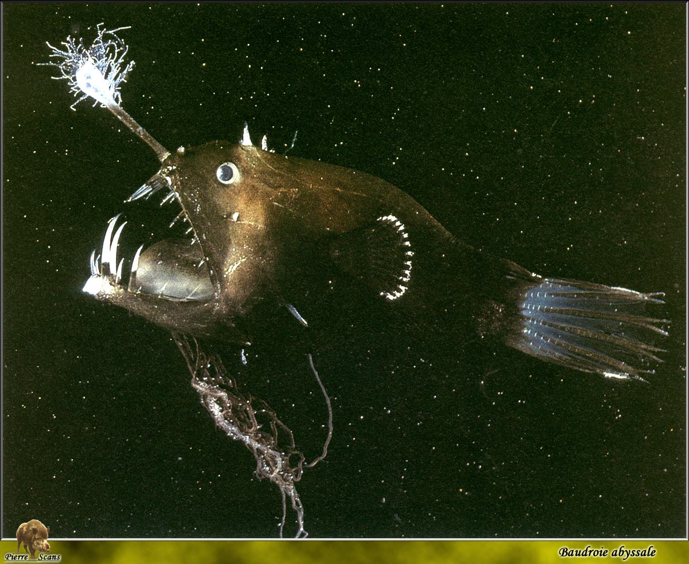
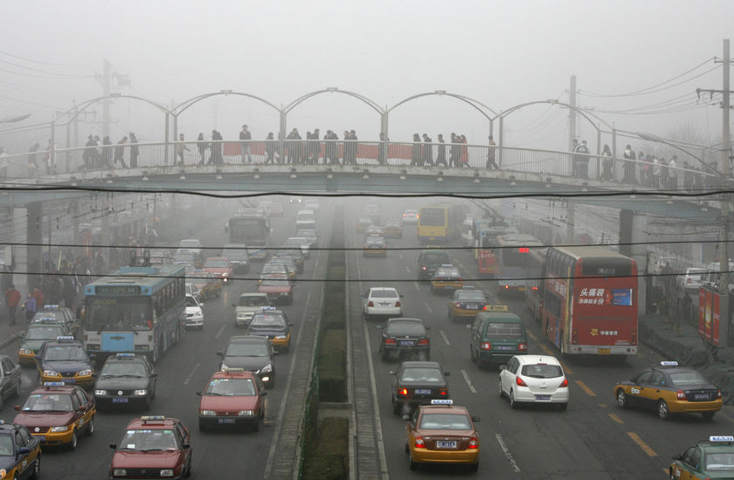
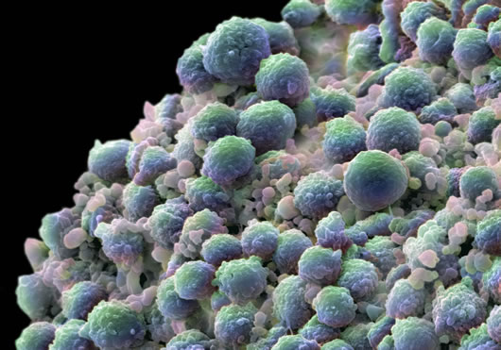
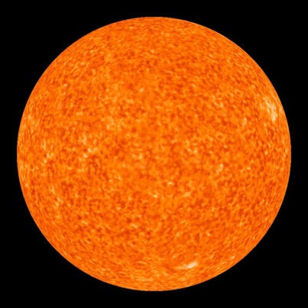
What starts a scientific investigation? An Unexplained Observation or a Problem!

Slide 3
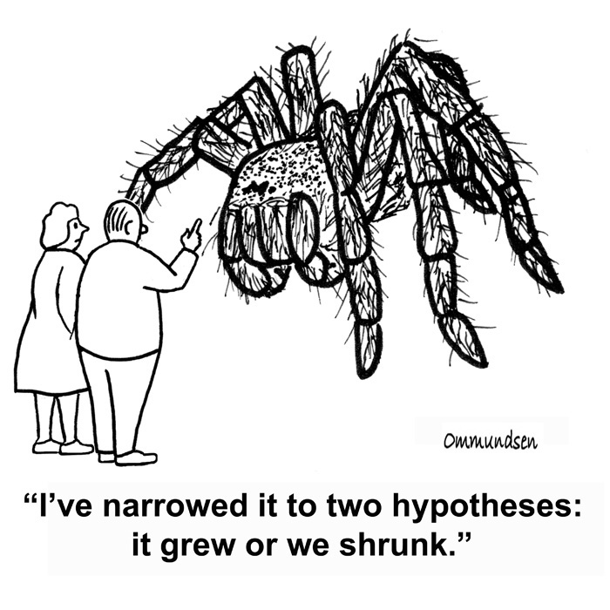
Then we form a hypothesis
What is a hypothesis?
- a possible explanation

Slide 4
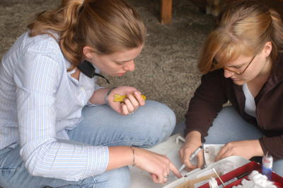
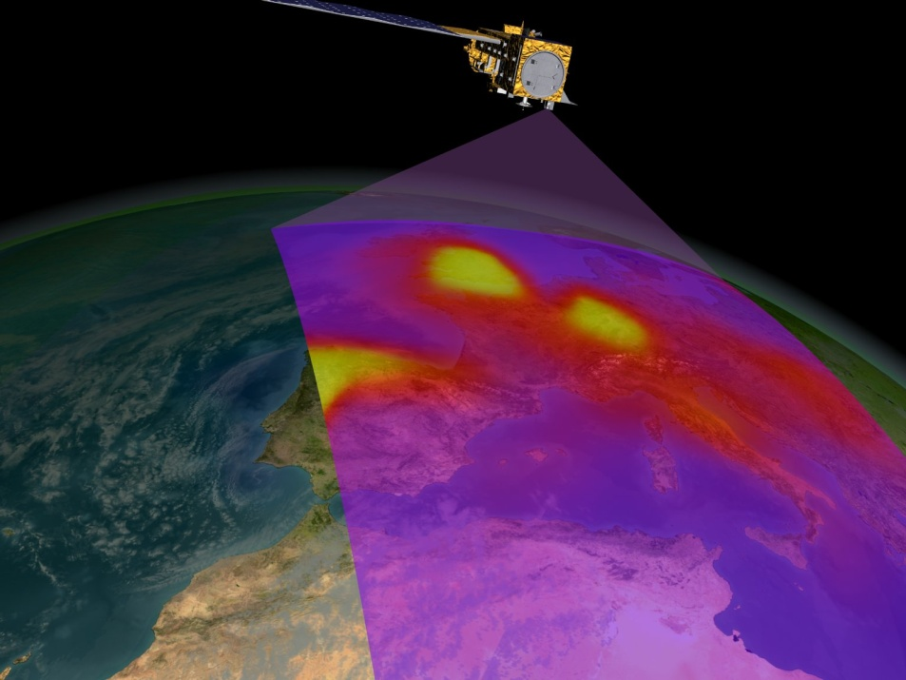
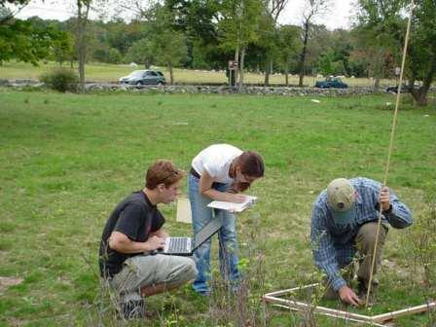
Hypotheses need to be supported with Evidence!
How do we gather evidence?
Collecting data!

Slide 5
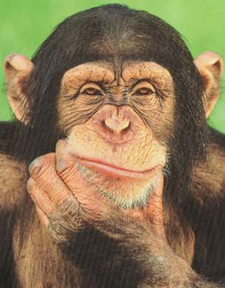
Does our evidence support our hypothesis? What does our data mean?
Yes? No? Maybe? Kind of?
How does our evidence compare to other scientists’ evidence?
Do we need to change our hypothesis?

Slide 6
Science involves…
Collecting evidence to test ideas!
A problem or unexplained observation
Hypotheses (possible explanations!)
Collecting evidence
Evaluating the evidence
Then…….

Slide 7
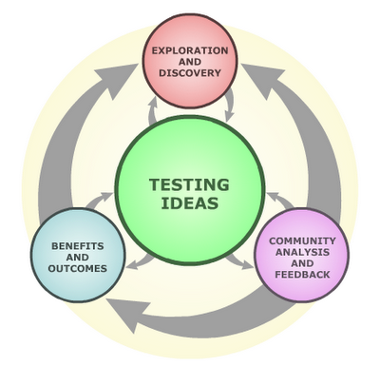
Science as a Process

Slide 8
Observation or Problem or Question
Form Hypotheses
Test Ideas
Interpret Results
(Talk to other scientists!)
Modify hypothesis

Slide 9
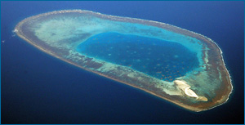
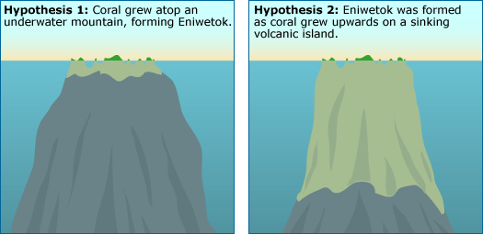
An example

Slide 10
Hypothesis Testing

Slide 12
Observation or Problem or Question
Form Hypotheses
Test Ideas
Interpret Results
(Talk to other scientists!)
Modify hypothesis

Slide 13
Each group gets one bag with an object inside of it
1.) Take a guess at what is in the bag
2.) now each student in the group lift the bag
3.) want to change your guess?
4.) now each student can touch the bag
5.) want to change your guess?
6.) now, without looking into the bag, reach in and feel what’s in there
7.) want to change your guess now?

