Slide 1
It’s All About Glucose
This project is supported by an AFRI Cap Grant no. 2011-68005-30407 from the USDA National Institute of Food and Agriculture (NIFA).

Slide 2
Activity Procedure
Label 6 paper squares. Rub dry sample
Label 6 cups (1-6)
Cup 1 – Cracker crumbs
Cup 2 – Marshmallows
Cup 3 – Peanut butter
Cup 4 – Apple sauce
Cup 5 – Corn kernel
Cup 6 – Biomass
Test each cup with glucose strip
Add two drops of iodine to each cup
Notes:
Activity:
Write material assignments on the board

Slide 3
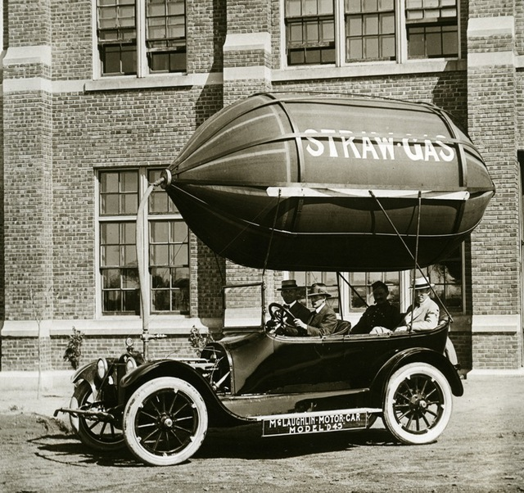
Is bioenergy practical?
Notes:
Is Bioenergy Practical?
Huge bioenergy boom? Guess?
1M vehicles converted
Germany
South Africa

Slide 4
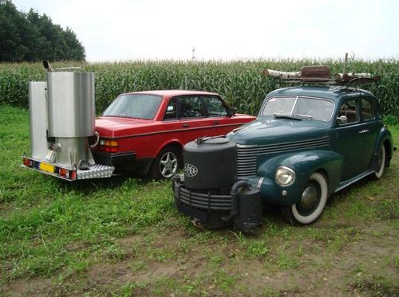

Slide 5
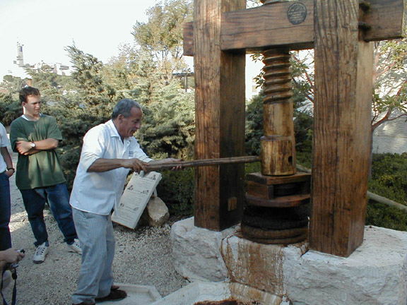
Mechanical Conversion
Notes:
Mechanical Conversions?

Slide 6
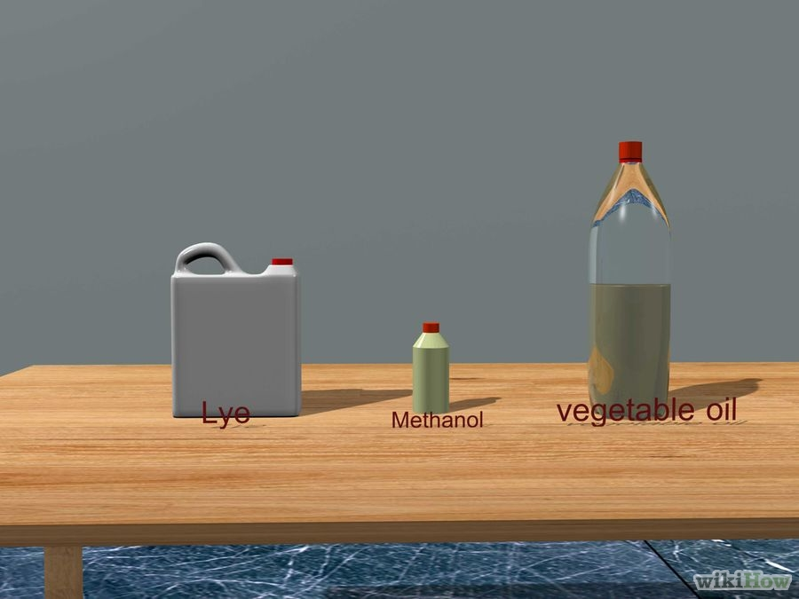
Chemical Conversions
WikiHow: Making Pop Bottle Diesel

Slide 7
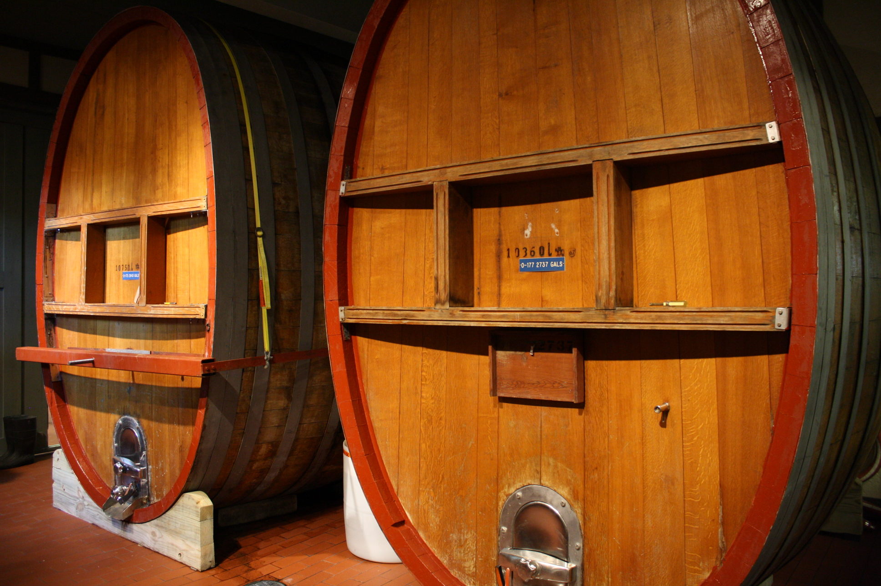
What are Biological Conversion?
Notes:
What are Biological Conversions?
ACTIVITY: Ask
Anerobic digestion
Fermentation

Slide 8
Which Materials Will Yeast Digest?
Cup 1 – Cracker crumbs
Cup 2 – Marshmallows
Cup 3 – Peanut butter
Cup 4 – Apple sauce
Cup 5 – Corn kernel
Cup 6 – Biomass
Notes:
Which Food to Yeast Like?

Slide 9
Linking the Yeast Experiment to Bioenergy
Is yeast plant, animal, or fungi?
Middle School?
Sugar + Yeast ➔
Alcohol + Carbon Dioxide
High School?
C₆H₁₂O₆ + Zymase →
2 C₂H₅OH + 2 CO₂

Slide 10
