Slide 1
Introduction to Chemical Engineering
SMILE 2016 Winter Teacher’s Workshop

Slide 2
ChemE Student Background
5th year student in Chemical Engineering
How I chose to be a ChemE
What I like about ChemE
Plans after graduation
Presenting my Senior Project at the OSU Engineering Expo, Spring 2015

Slide 3
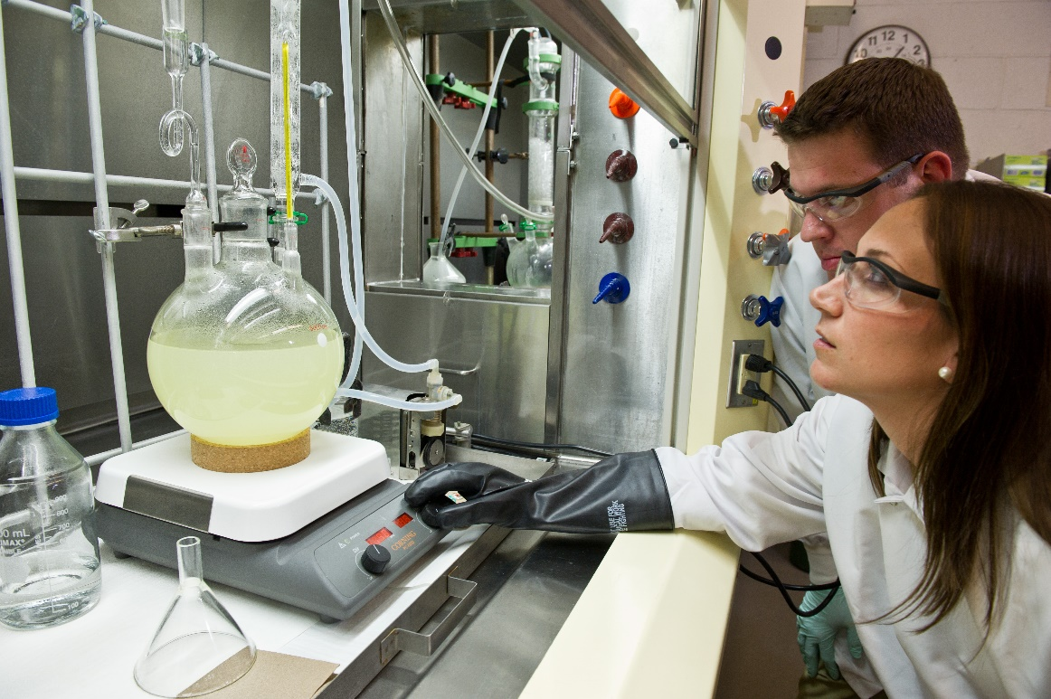
What are Chemical Engineers?
Use knowledge of mathematics & science, particularly chemistry, to overcome problems safely & economically

Slide 4
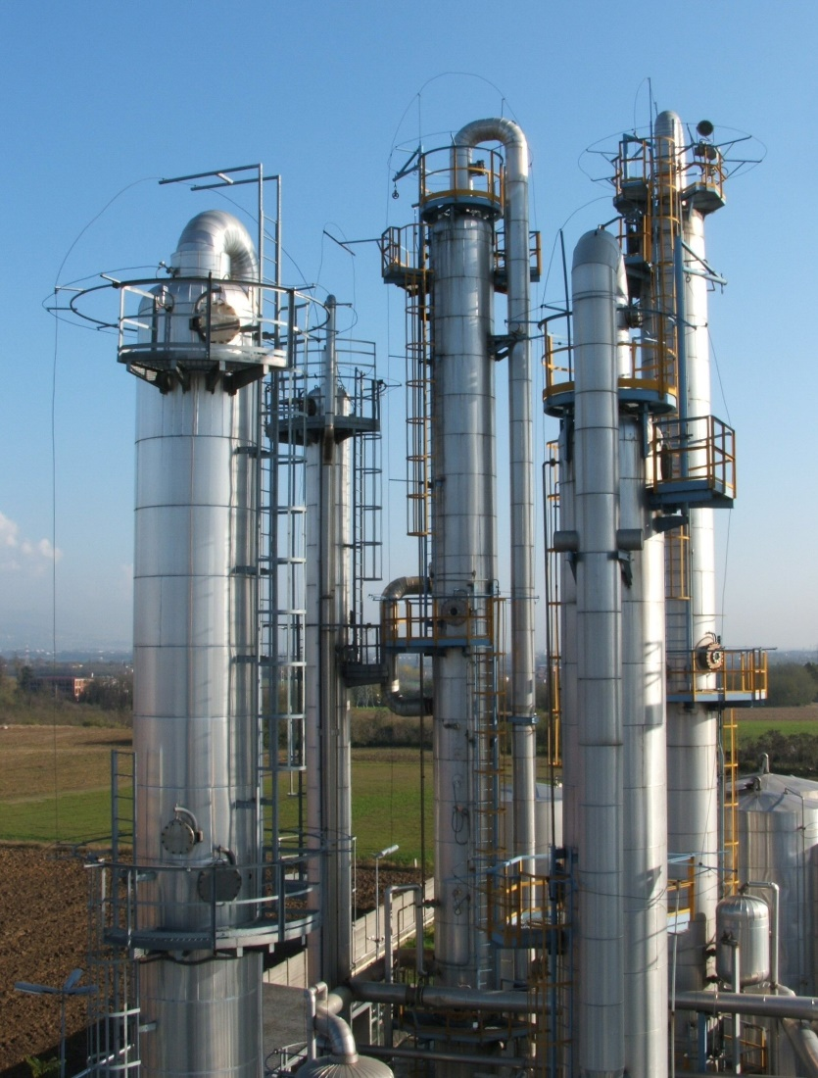
Problems Chemical Engineers Work On:
Food production
Develop new materials from microelectronics to textiles
Environmental concerns
Mass-produce affordable & safe drugs
Make productive & cost effective energy sources

Slide 5
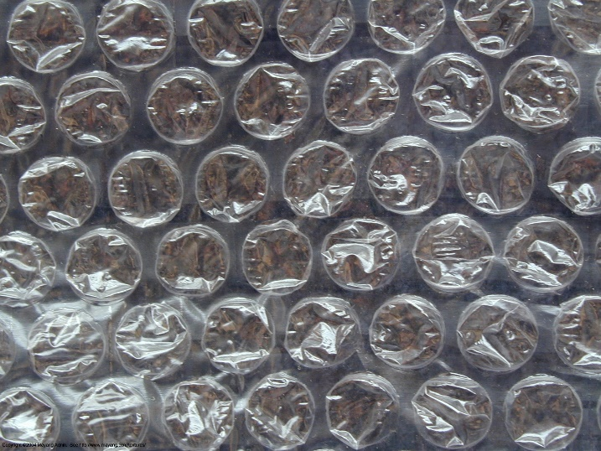
Famous Chemical Engineering Products

Slide 6
Chemical Engineering Activities

Slide 7
References:
http://www.aiche.org/community/students/career-resources-k-12-students-parents/what-do-chemical-engineers-do
http://www.thechemicalengineer.com/chemical-engineers-who-changed-the-world.aspx

