Slide 1
Embedded Systems Workshop 2
3/6/19

Slide 2
Watchdog Timers
Avoid hardware stalling/getting stuck and failing
Avoid infinite loops

Slide 3
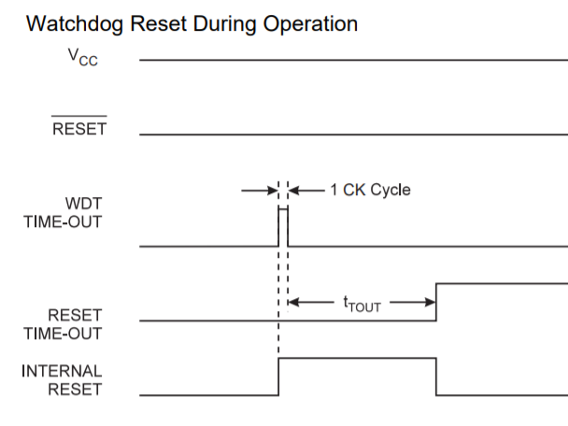
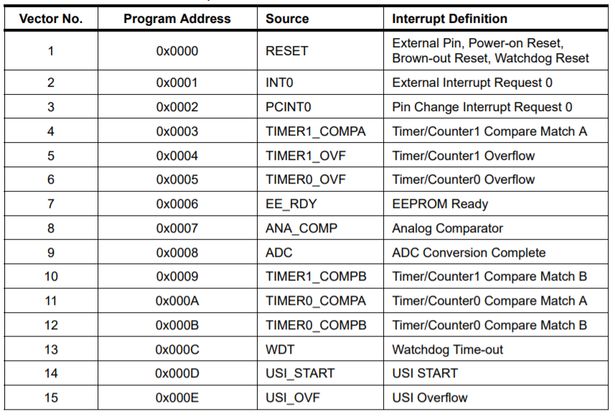
Two Operation Modes

Slide 4
Important Registers

Slide 5
Important Registers
Watchdog Enable
Watchdog Timer Interrupt Flag
Watchdog Change Enable
Watchdog Timer Interrupt Enable

Slide 6
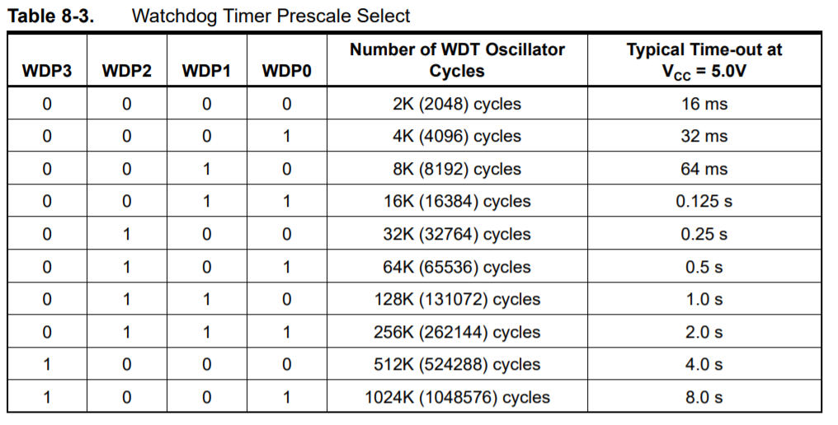
Important Registers
Watchdog Timer Prescaler
Watchdog Enable
Watchdog Timer Interrupt Flag
Watchdog Change Enable
Watchdog Timer Interrupt Enable

Slide 7
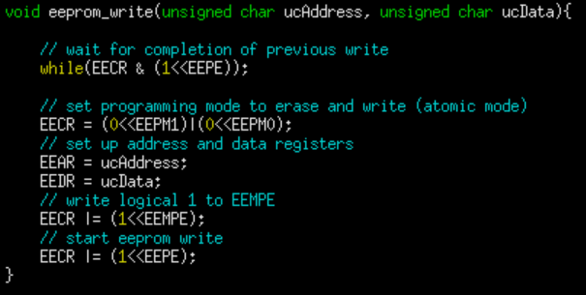
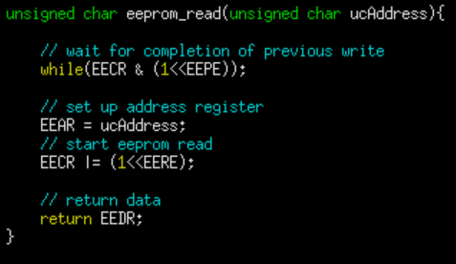
Reading/Writing EEPROM

Slide 8
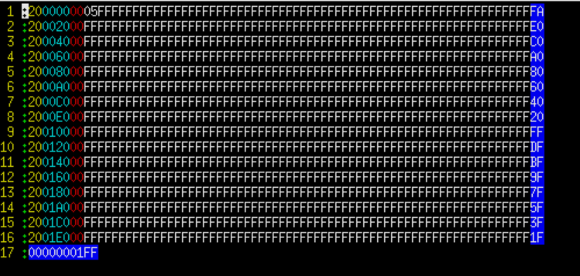
Reading EEPROM with Avrdude
sudo avrdude –c usbasp –p t85 –U eeprom:r:eedump.hex:i

