Slide 1
Myths about College
The Office of Precollege Programs

Slide 2

True or False:
To make it in today’s world, you need a four-year college degree.

Slide 3
FALSE!
A four-year degree will give you more career options, but there are many satisfying and good-paying jobs that are possible with technical or two-year degrees.
Education beyond high school is key!

Slide 4
Types of Post-Secondary Education
Associate’s Degree
Bachelor’s Degree in Science/Art
Master’s Degree
PhD
Notes:
An Associate’s degree is a two-year degree that can be earned at a community College.
A Bachelor’s Degree takes around 4 years and is from a University.
Master’s and PhD degree are awarded at Universities and are in addition to Bachelor’s.

Slide 5




Examples of Associate Degree and Certificate Programs
This is a small selection of the many two-year and certificate programs that are available at Oregon Community Colleges.
Portland Community College
Alcohol and Drug Counselor
Building Inspection Technology
Dental Assistant
Linn Benton Community College
Animal Technology
Automotive Technology
Diagnostic Imaging
Veterinary Assistant
Welding & Fabrication Technology
Oregon Coast Community College
Aquarium Science
Emergency Medical Technician
Nursing
Chemeketa Community College
Drafting Technology
Early Childhood Education
Fire Protection

Slide 6

True or False:
On average, the more education you have, the more money you make.

Slide 7

TRUE!
The more education you have, the more money you make and the more choices you have on how and where you work!

Slide 8
True or False:
You have to know exactly what you want to study and what kind of career you want when you go to college.

Slide 9
FALSE!
The great thing about college is you DON’T have to know exactly what you want to study, and you DEFINITELY don’t have to know what career you want right away.
  Most schools have exploratory programs
  Bacc Core courses allow you to explore

Slide 10

True or False:
You can afford a college education.
Notes:
Degree Partnership Program is where students can go to school at OSU and a community college to save money

Slide 11
TRUE!
EVERYONE CAN AFFORD COLLEGE
Help is available:
      Scholarships
      Grants
      Student Loans
      Parent Loans
      Student Employment
      Degree Partnership Program

Slide 12

True or False:
Scholarships, Grants and Student Loans are FREE MONEY.

Slide 13

FALSE!
Loans must be paid back. Only scholarships and grants do not have to be repaid.

Slide 14

True or False:
Scholarships are only for
“A+” students.

Slide 15
FALSE!
Good grades always help, but there are thousands of scholarships:
http://www.fastweb.com/
OSAC (Oregon Student Access Commission) – one application for over 450 scholarships and nearly $70 million every year
School specific scholarships
Community scholarships

Slide 16
True or False:
You need to start planning for college during your junior year of high school.

Slide 17
FALSE!
What you do in middle and high school is important!
  Courses and grades are the most important consideration in most colleges’ admissions decisions
  Extracurricular activities
Start planning NOW!

Slide 18

What can you do now?
Make school a priority
  Work hard in school
  If you’re having trouble – ask for help!
Plan your high school classes
  English 4 years
  Math 3 years (need Algebra II or higher)
  Social Studies 3 years
  Science 3 years
  Foreign language 2 years
Notes:
Plan your high school classes – these are the requirements to get into OSU

Slide 19
What else can you do now?
Visit a College Campus
Talk to your parent or teacher about college
Explore your interests!
  www.sciencebuddies.org
  www.collegeboard.com
Volunteer! Get involved!
Notes:
Sciencebuddies.org – Science, Technology, Engineering, and Math career exploration

Slide 20


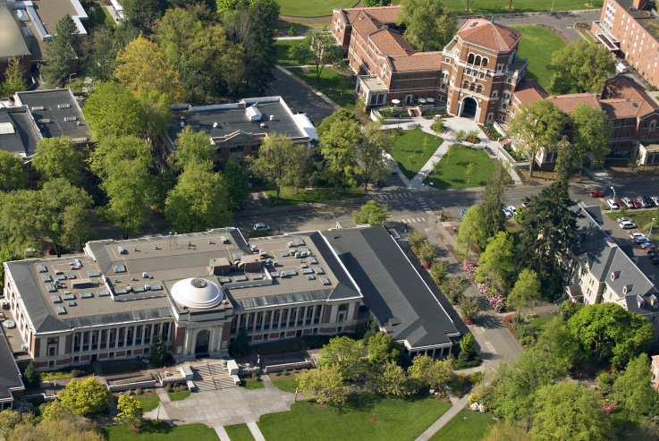


Questions about College or OSU?

